Slide 1

The Inductive Games
Hack Cu X
Spencer Wilson

Slide 2
Induction is hard to learn because…

Slide 3
Induction is hard to learn because
Induction is hard to learn.

Slide 4
Induction is hard to learn because
Induction is hard to learn.
(that’s just a little induction humor for you)

Slide 5
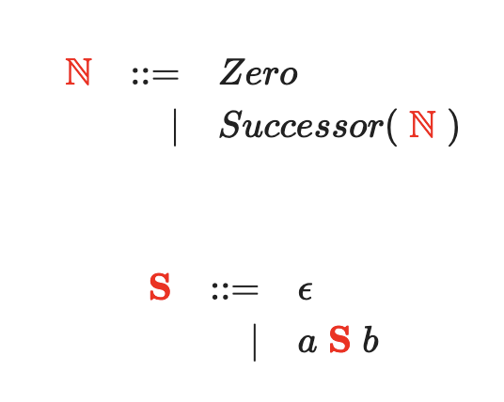
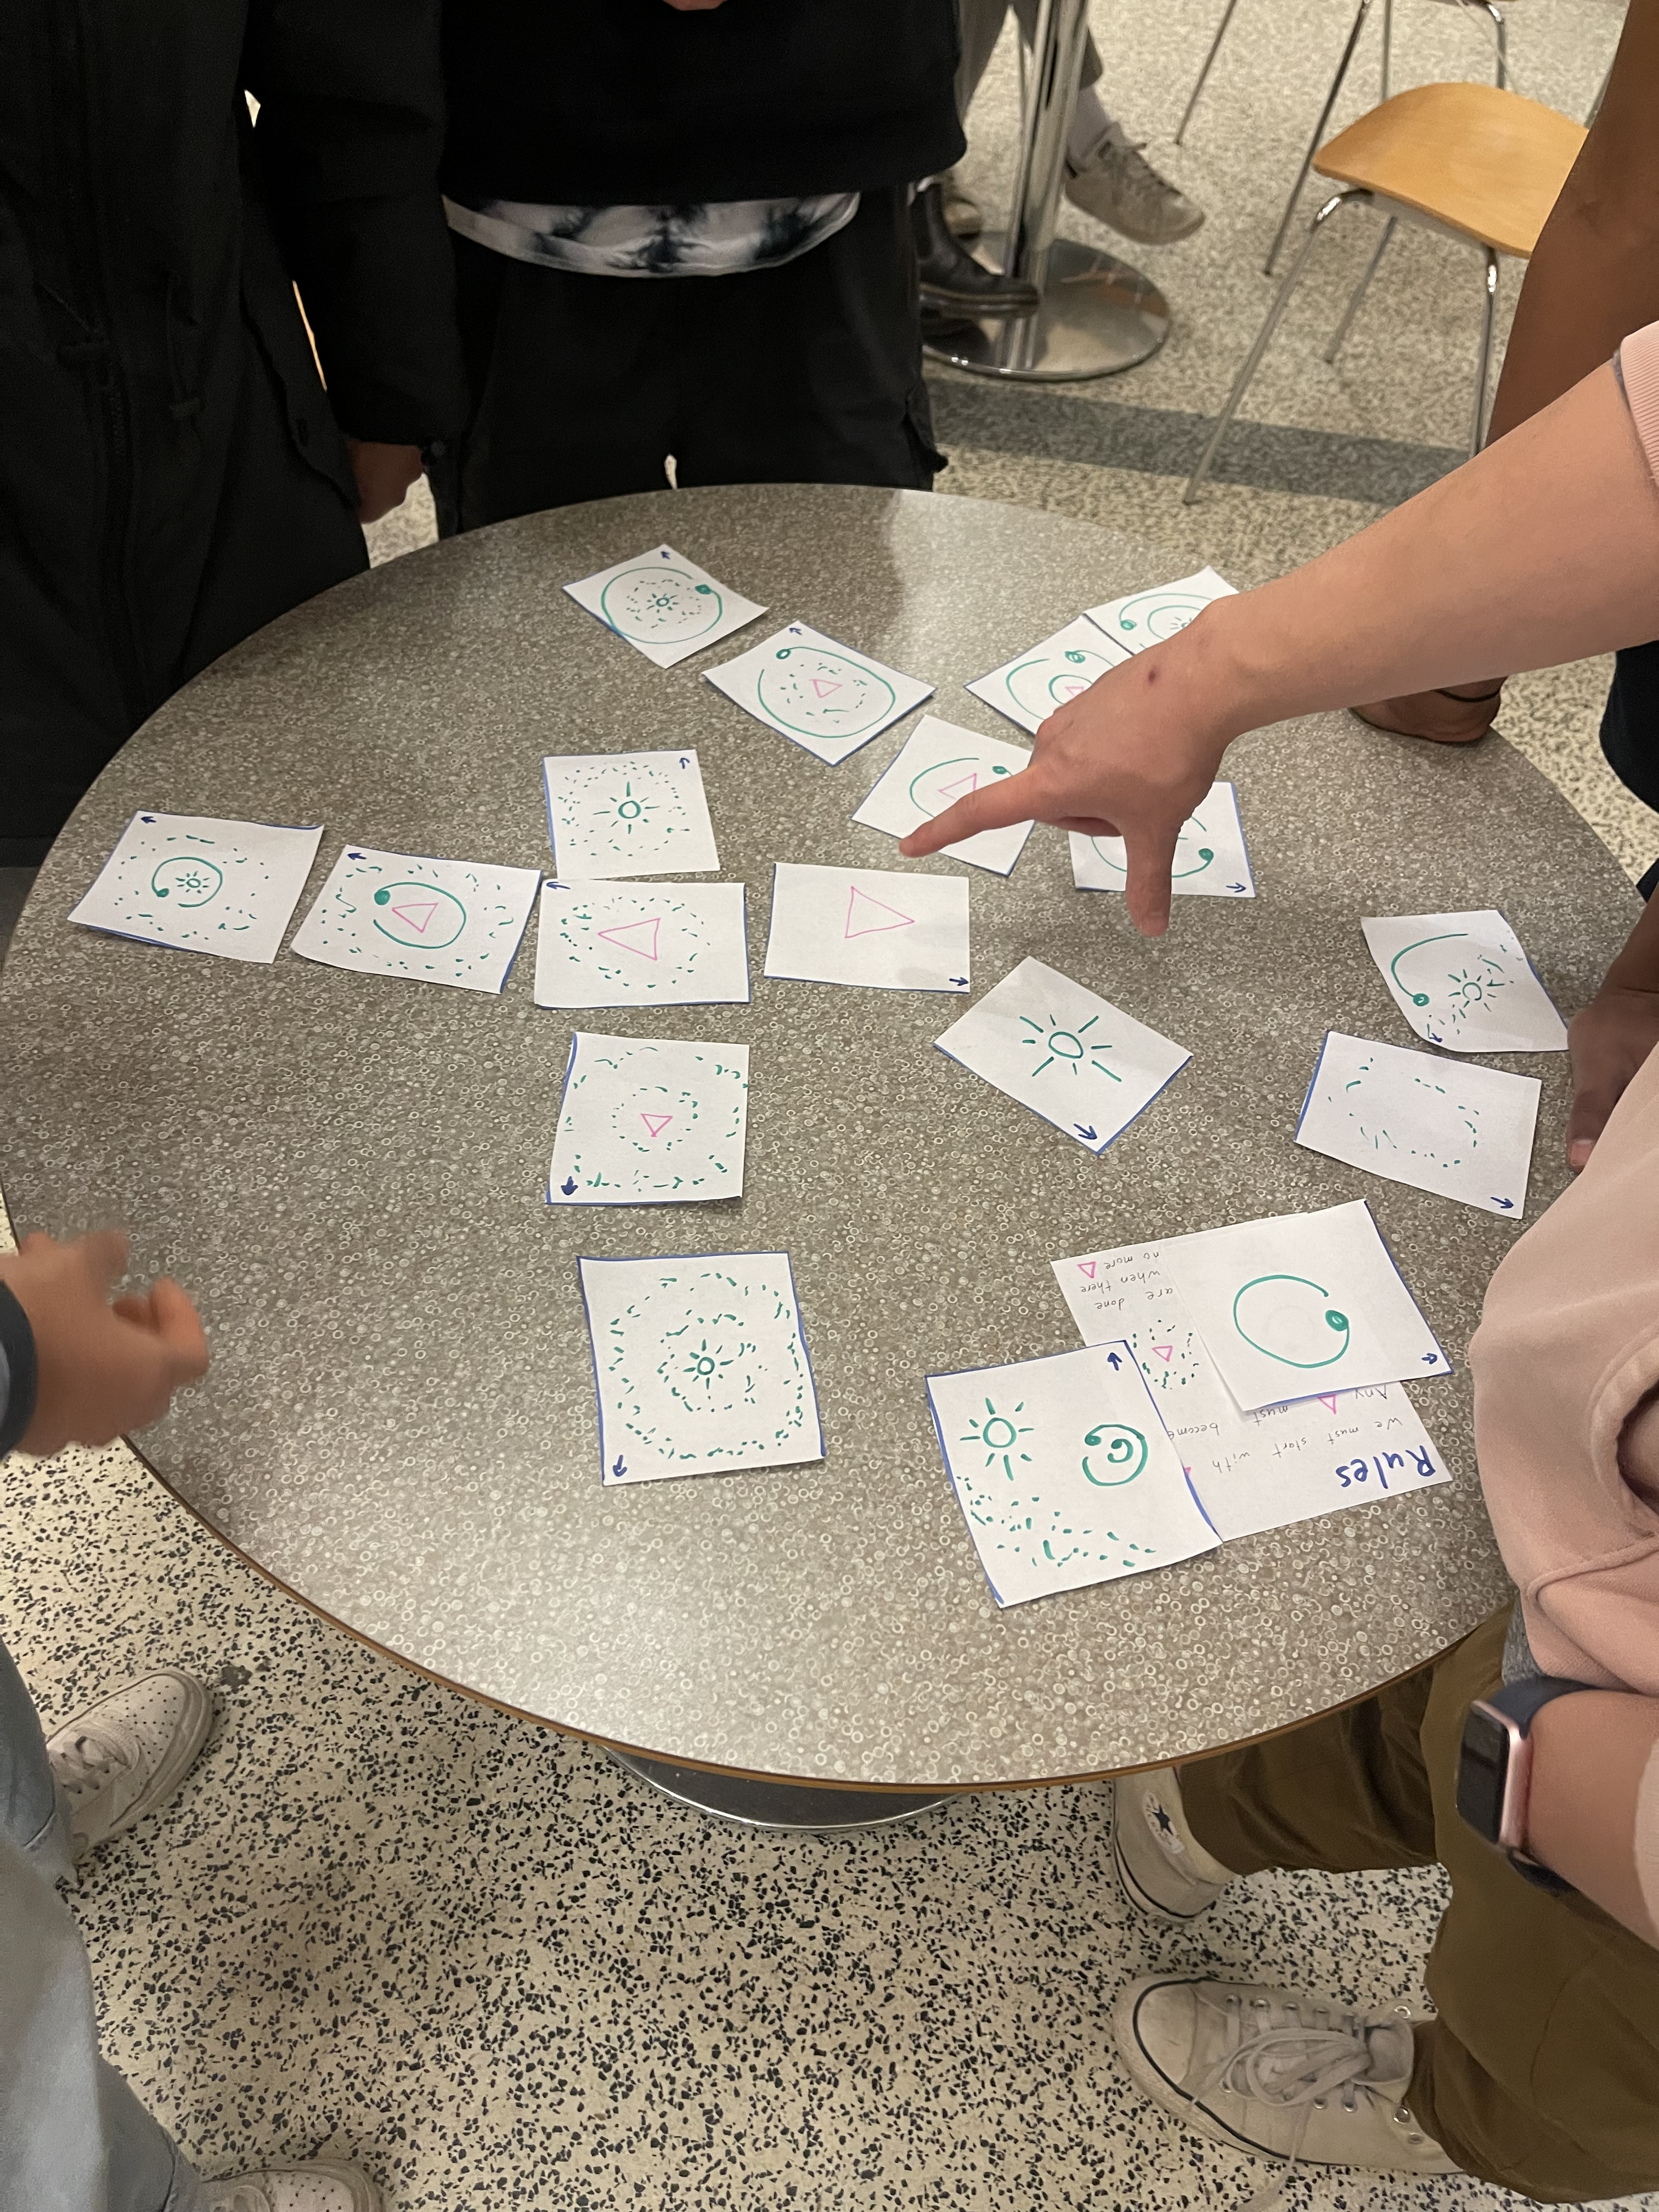
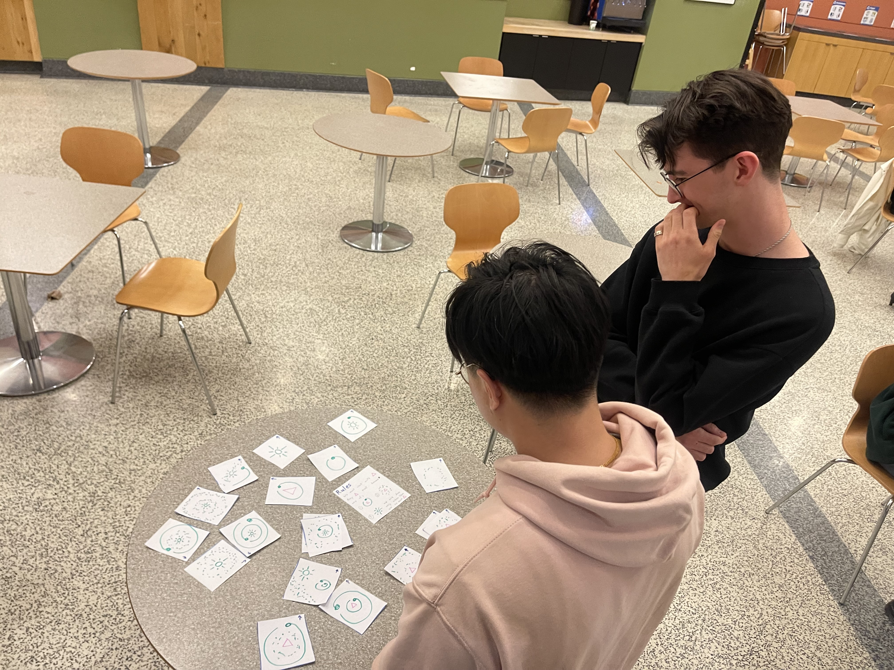
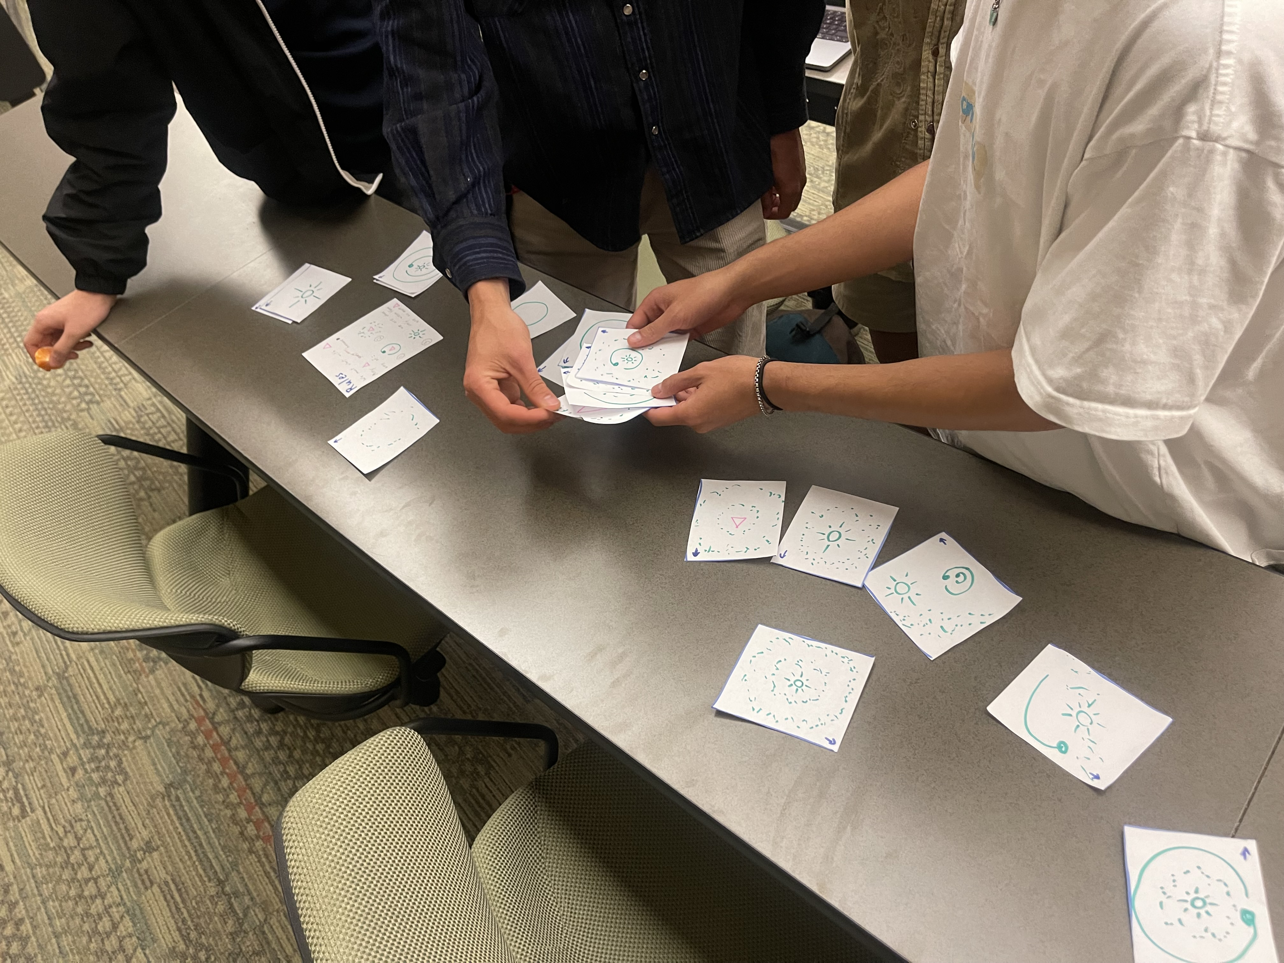
Induction can be hard to learn (so let’s make it fun)
The Old Way
Our Method
N => Zero
N => S(N) => S(Z)
N => S(N) => S(S(N)) => S(S(Z))
N => S(N) => S(S(N)) => S(S(S(N))) => S(S(S(Z)))
…
S => ‘’
S => aSb => ab
S => aSb => aaSbb => aabb
…

Slide 6




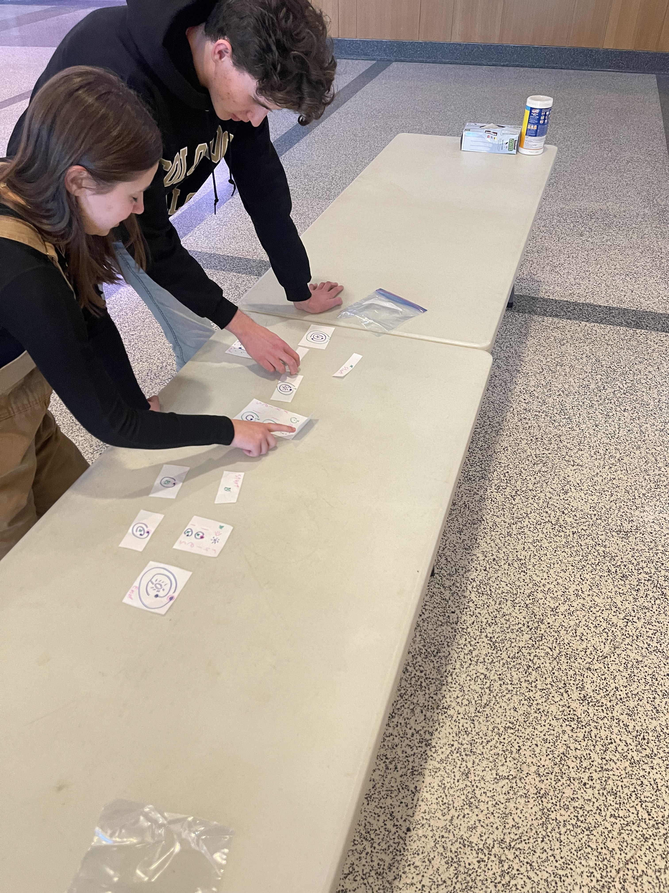
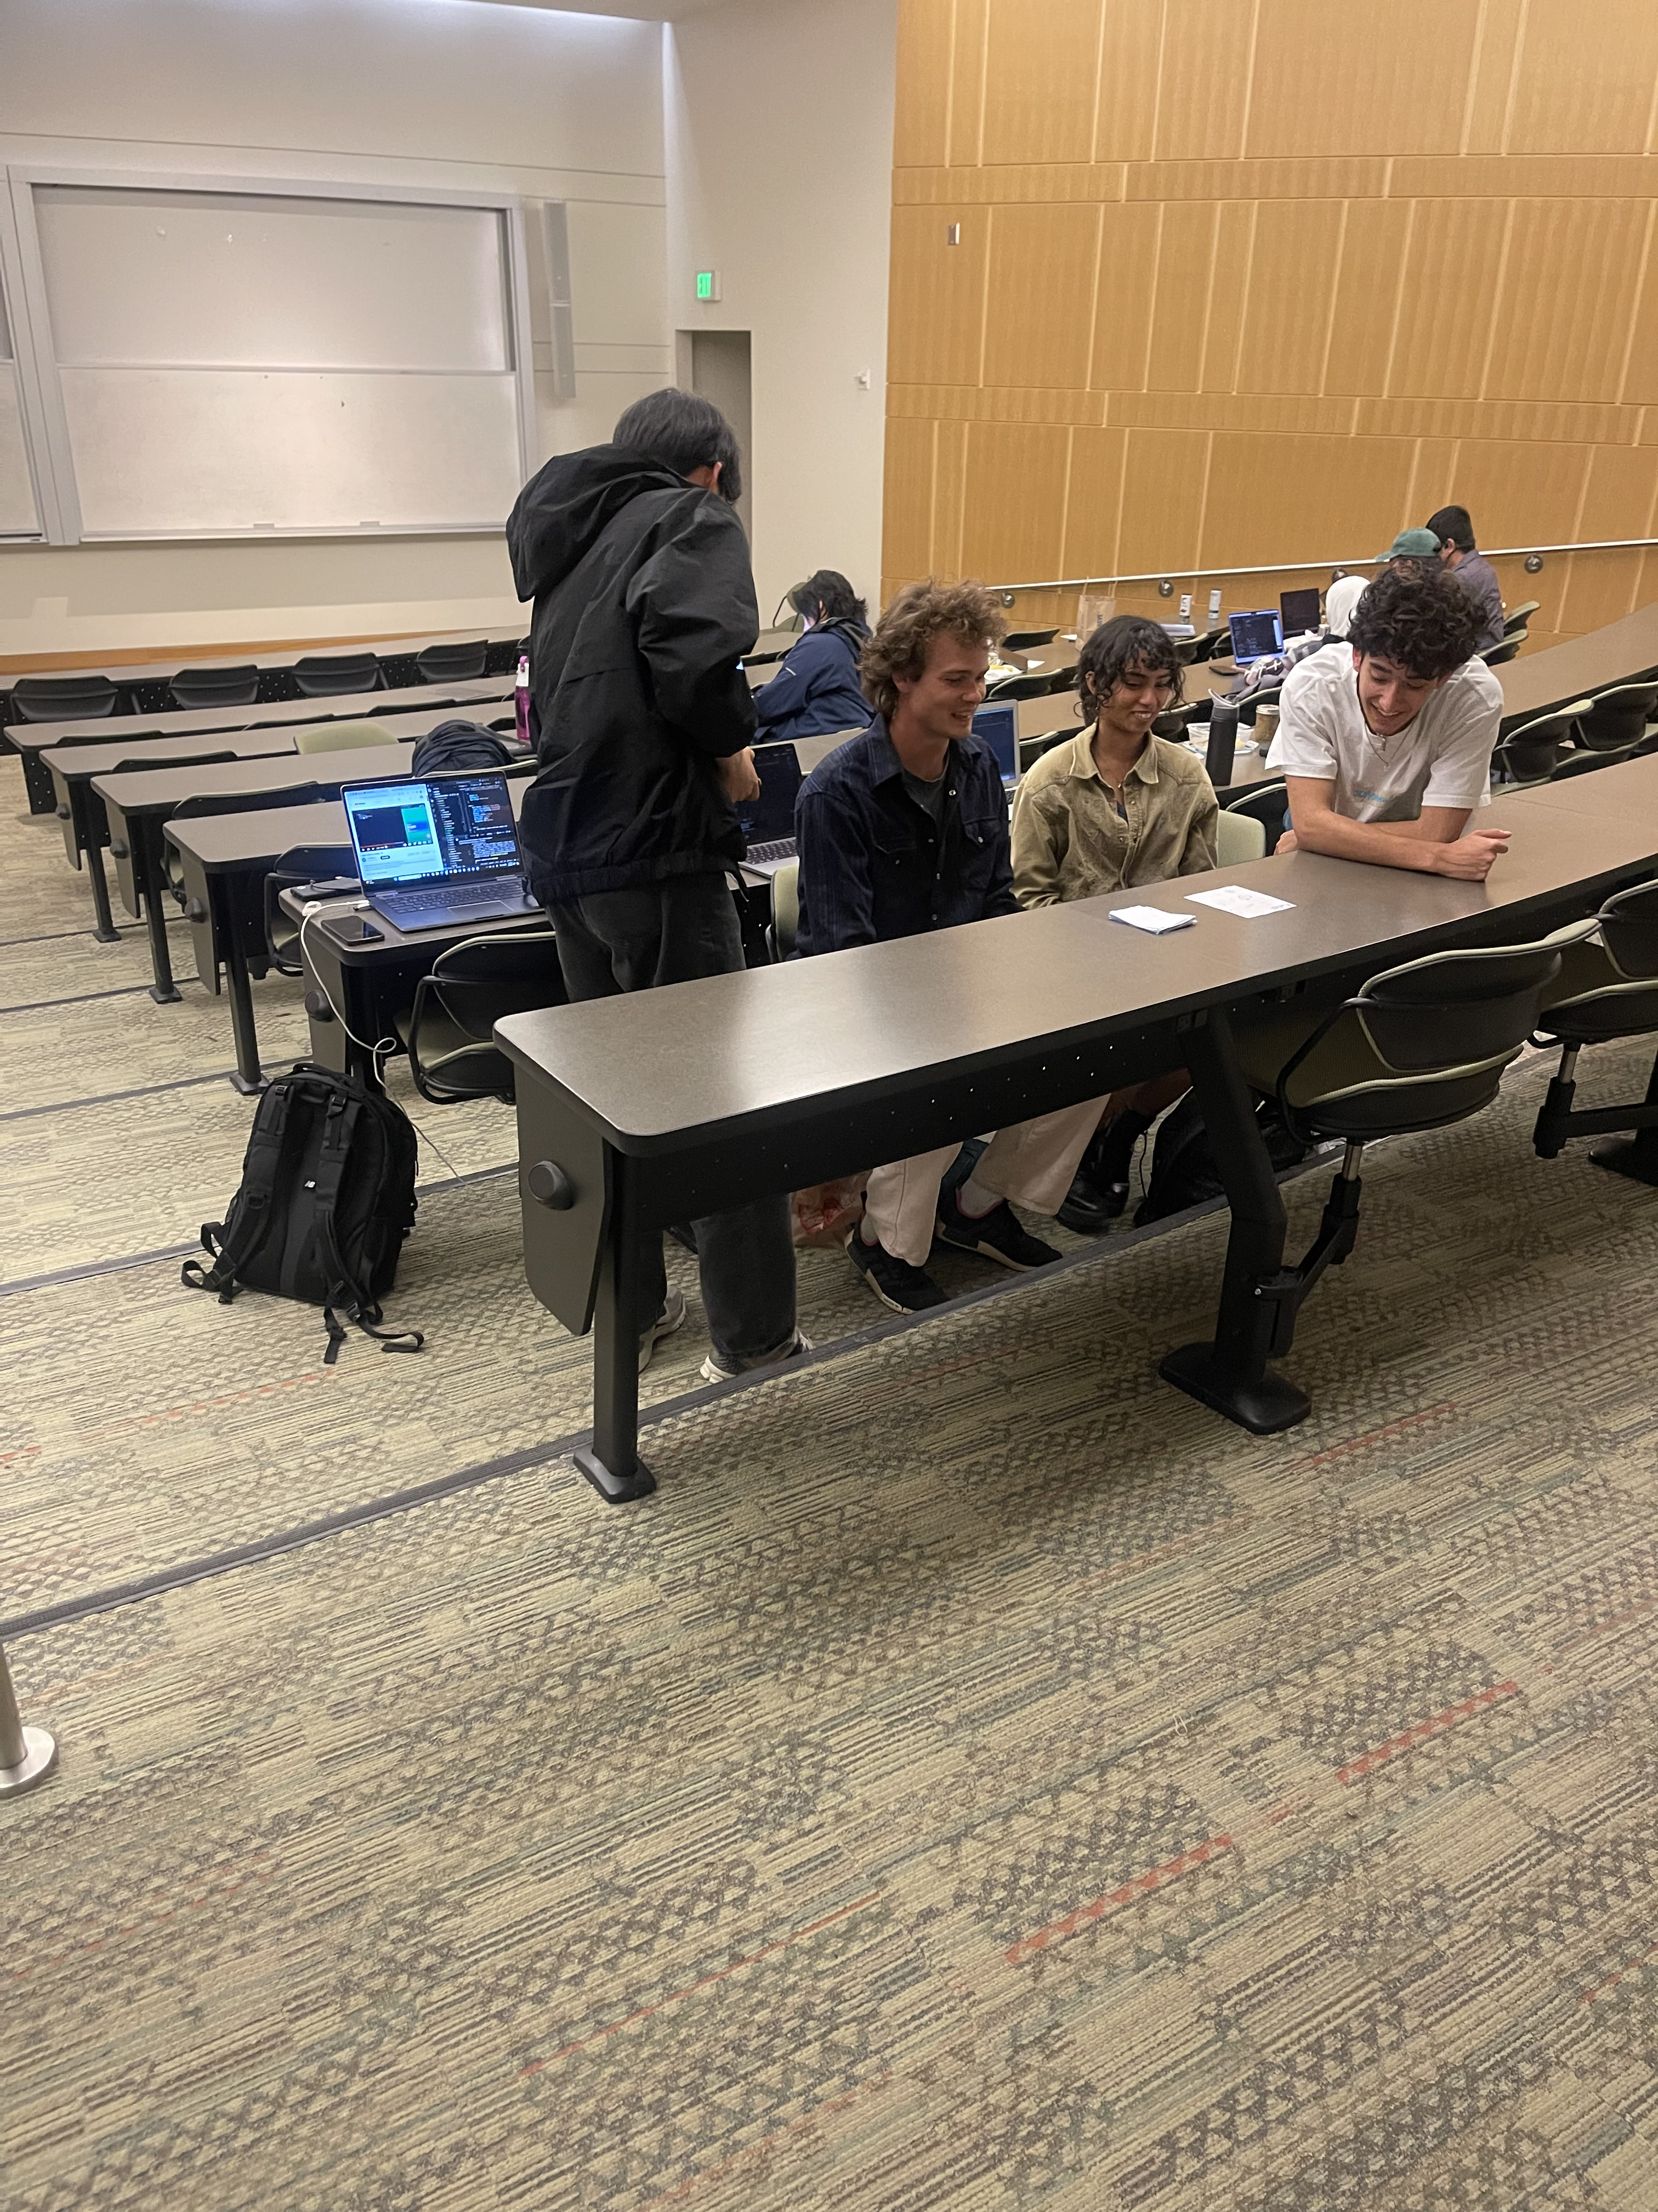
Who is this for?
Learners that want to strengthen their inductive problem solving skills
Educators that wish to understand how their learners conceptualize inductive problem solving and assist in growing that skill.

Slide 7
Let the games begin

Slide 8
Link List Laugh
Rules:
Make what you can given:
N should be a number
Should become either:
n

Slide 9
Rules:
100
Make what you can given:
25
N should be a number
Should become either:
n
100
100
100
25

Slide 10
100
100
25
25
25
789
789
789
789
789

Slide 11
An Abstract Abstract Syntax Tree

Slide 12
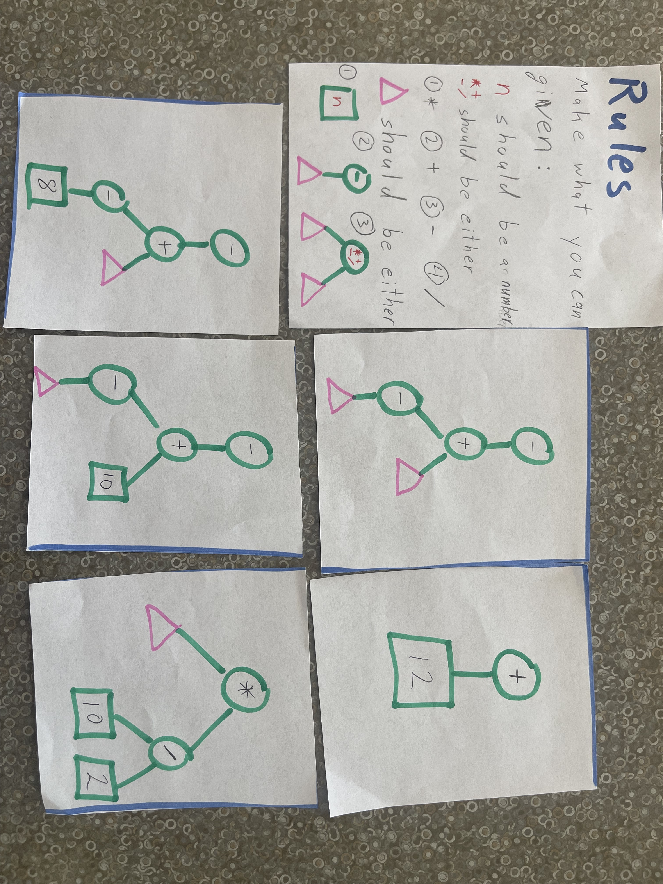

Slide 13
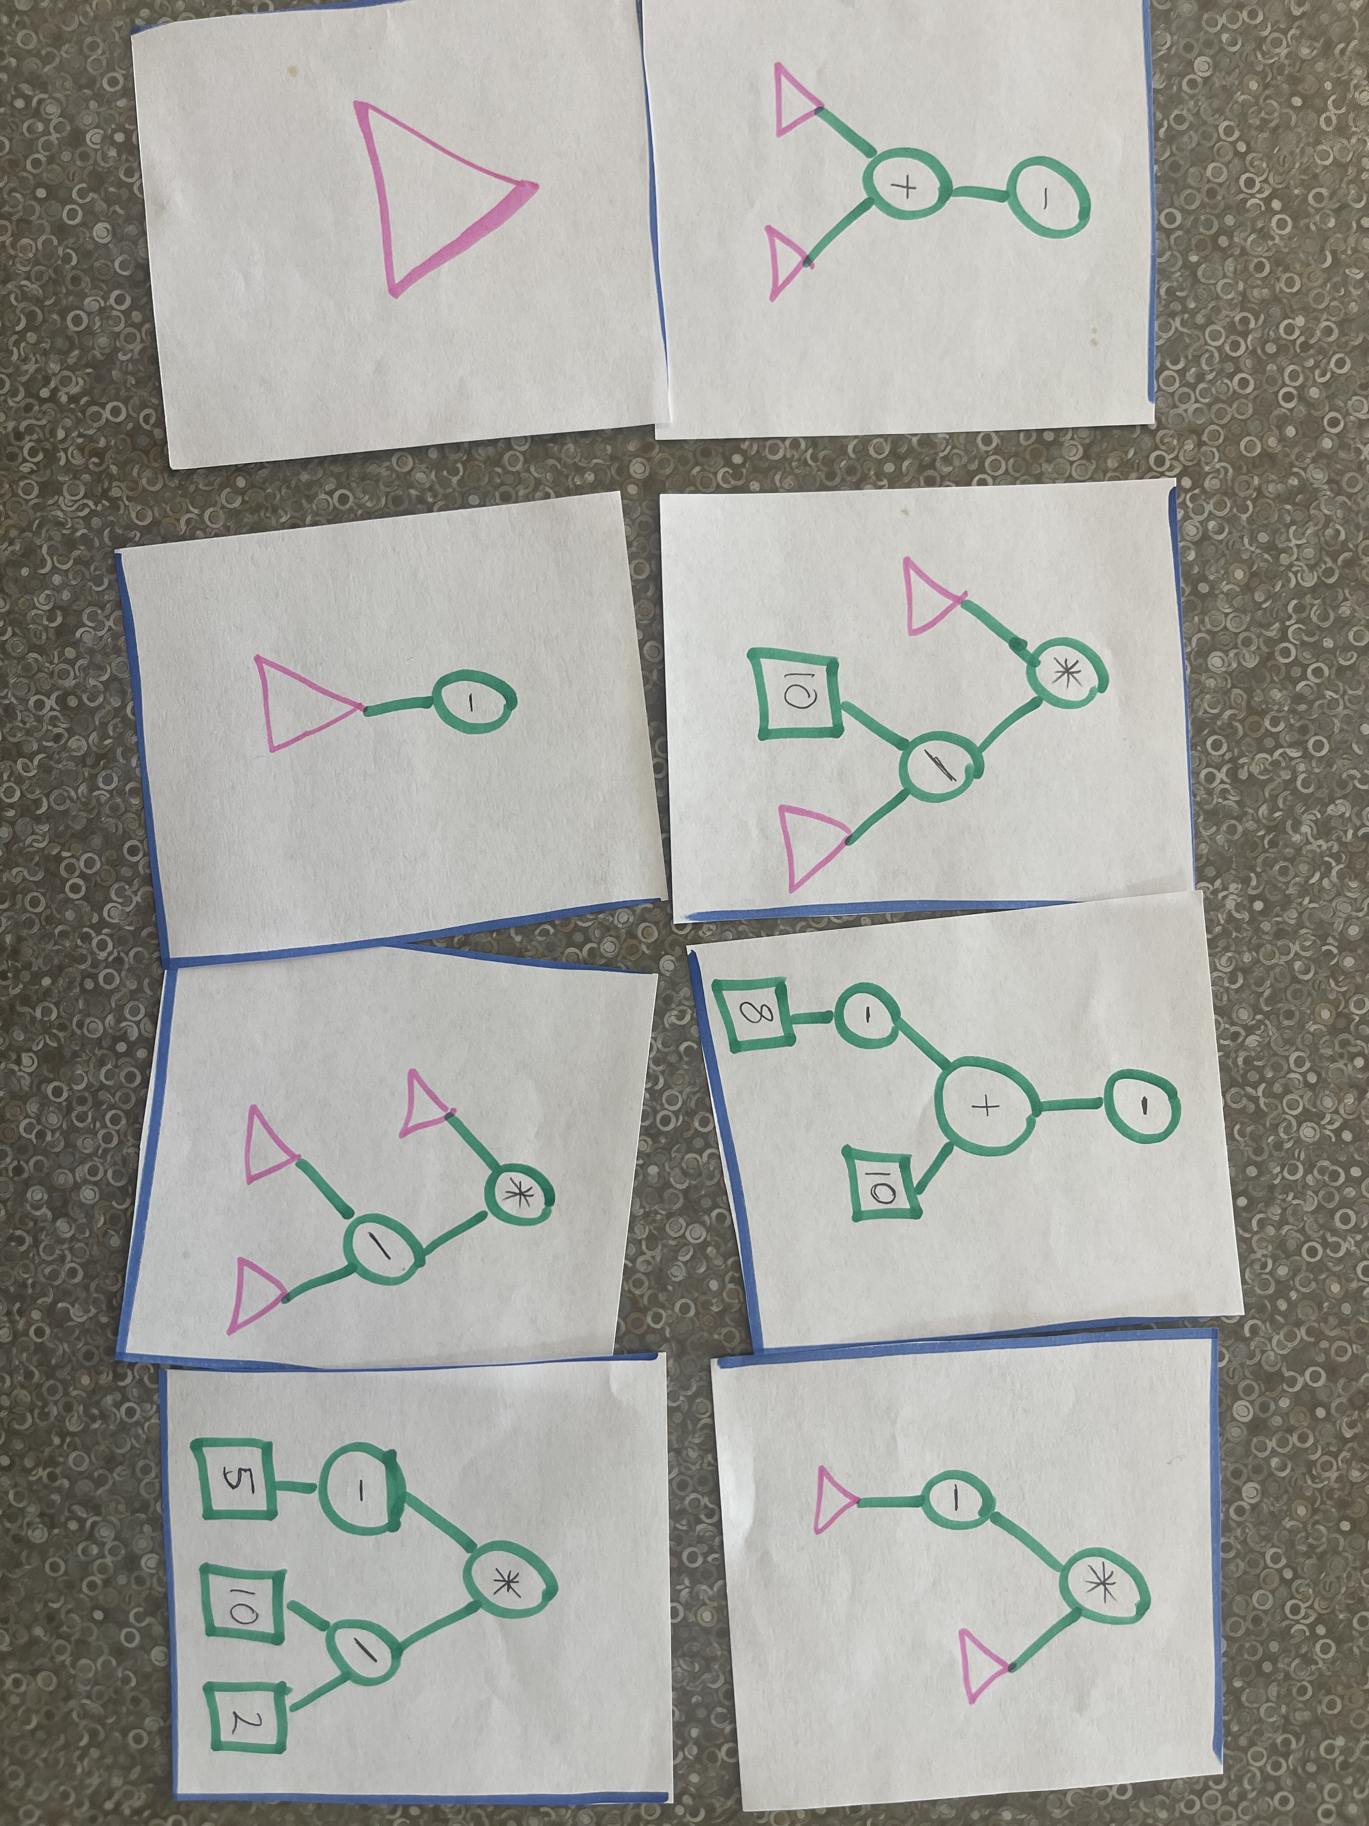

Slide 14
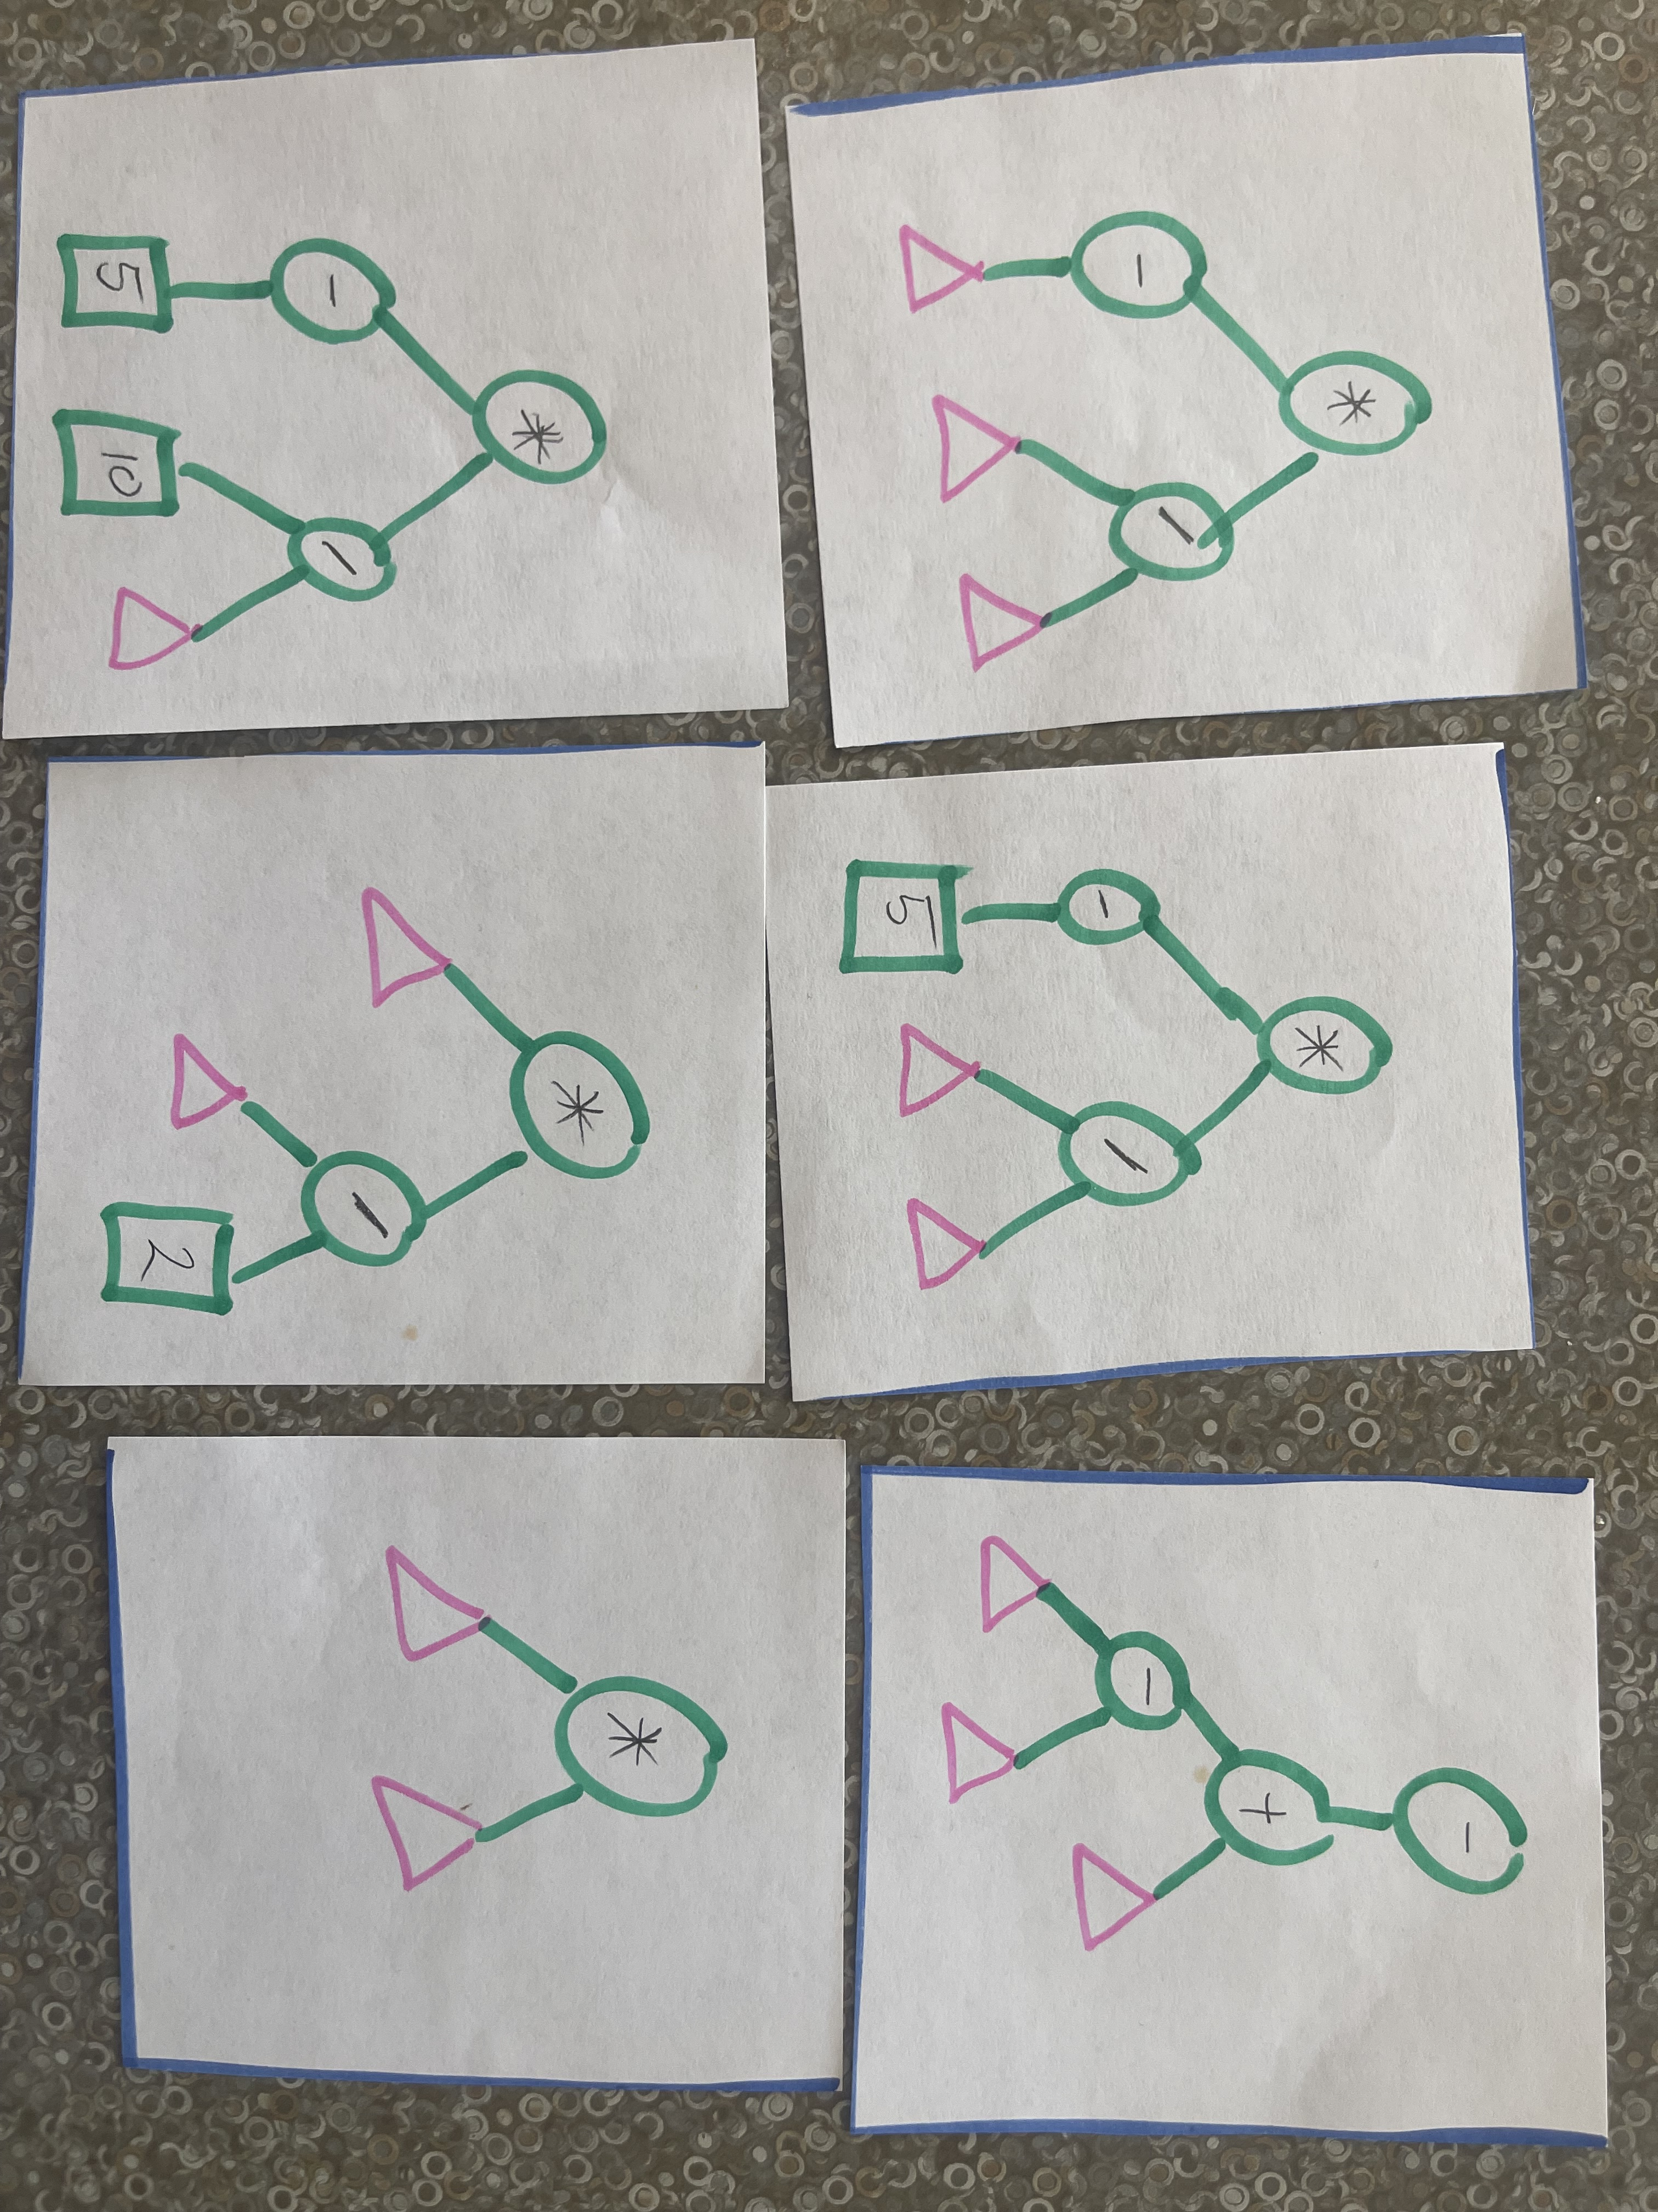

Slide 15



Solar Inductive Systems
Rules:
Should become either:

Slide 16

Rules:
Make what you can given:
Should become either:

Slide 17



Slide 19
Make Your Own Game
Rules:
Construct a game of your own design
(design by learners)

Slide 21
How it works
Print one of the above games or make up your own hexo-cards game using the template provided. Cut out the hexo-cards provided.
It’s less about getting the “right” answer, and more about being willing to try things and explain your logic.
We recommend teams of two, but you can play the game alone or play with larger groups if you prefer.

Slide 22
Tips for Educators
Encourage Collaboration. Encourage Creativity.
If a learner gets stuck, the educator might consider:
To encourage the learner to see what other students have come up with and ask their peers about their thought process
To shuffle the cards and iterate on new possibilities
To add constraints to the problem e.g.:
Tell the learner that the triangle is the starting position
Tell the learner that this one specific item is one possible ending position
Remove some of the intentionally misleading items from the hexo-cards

Slide 23
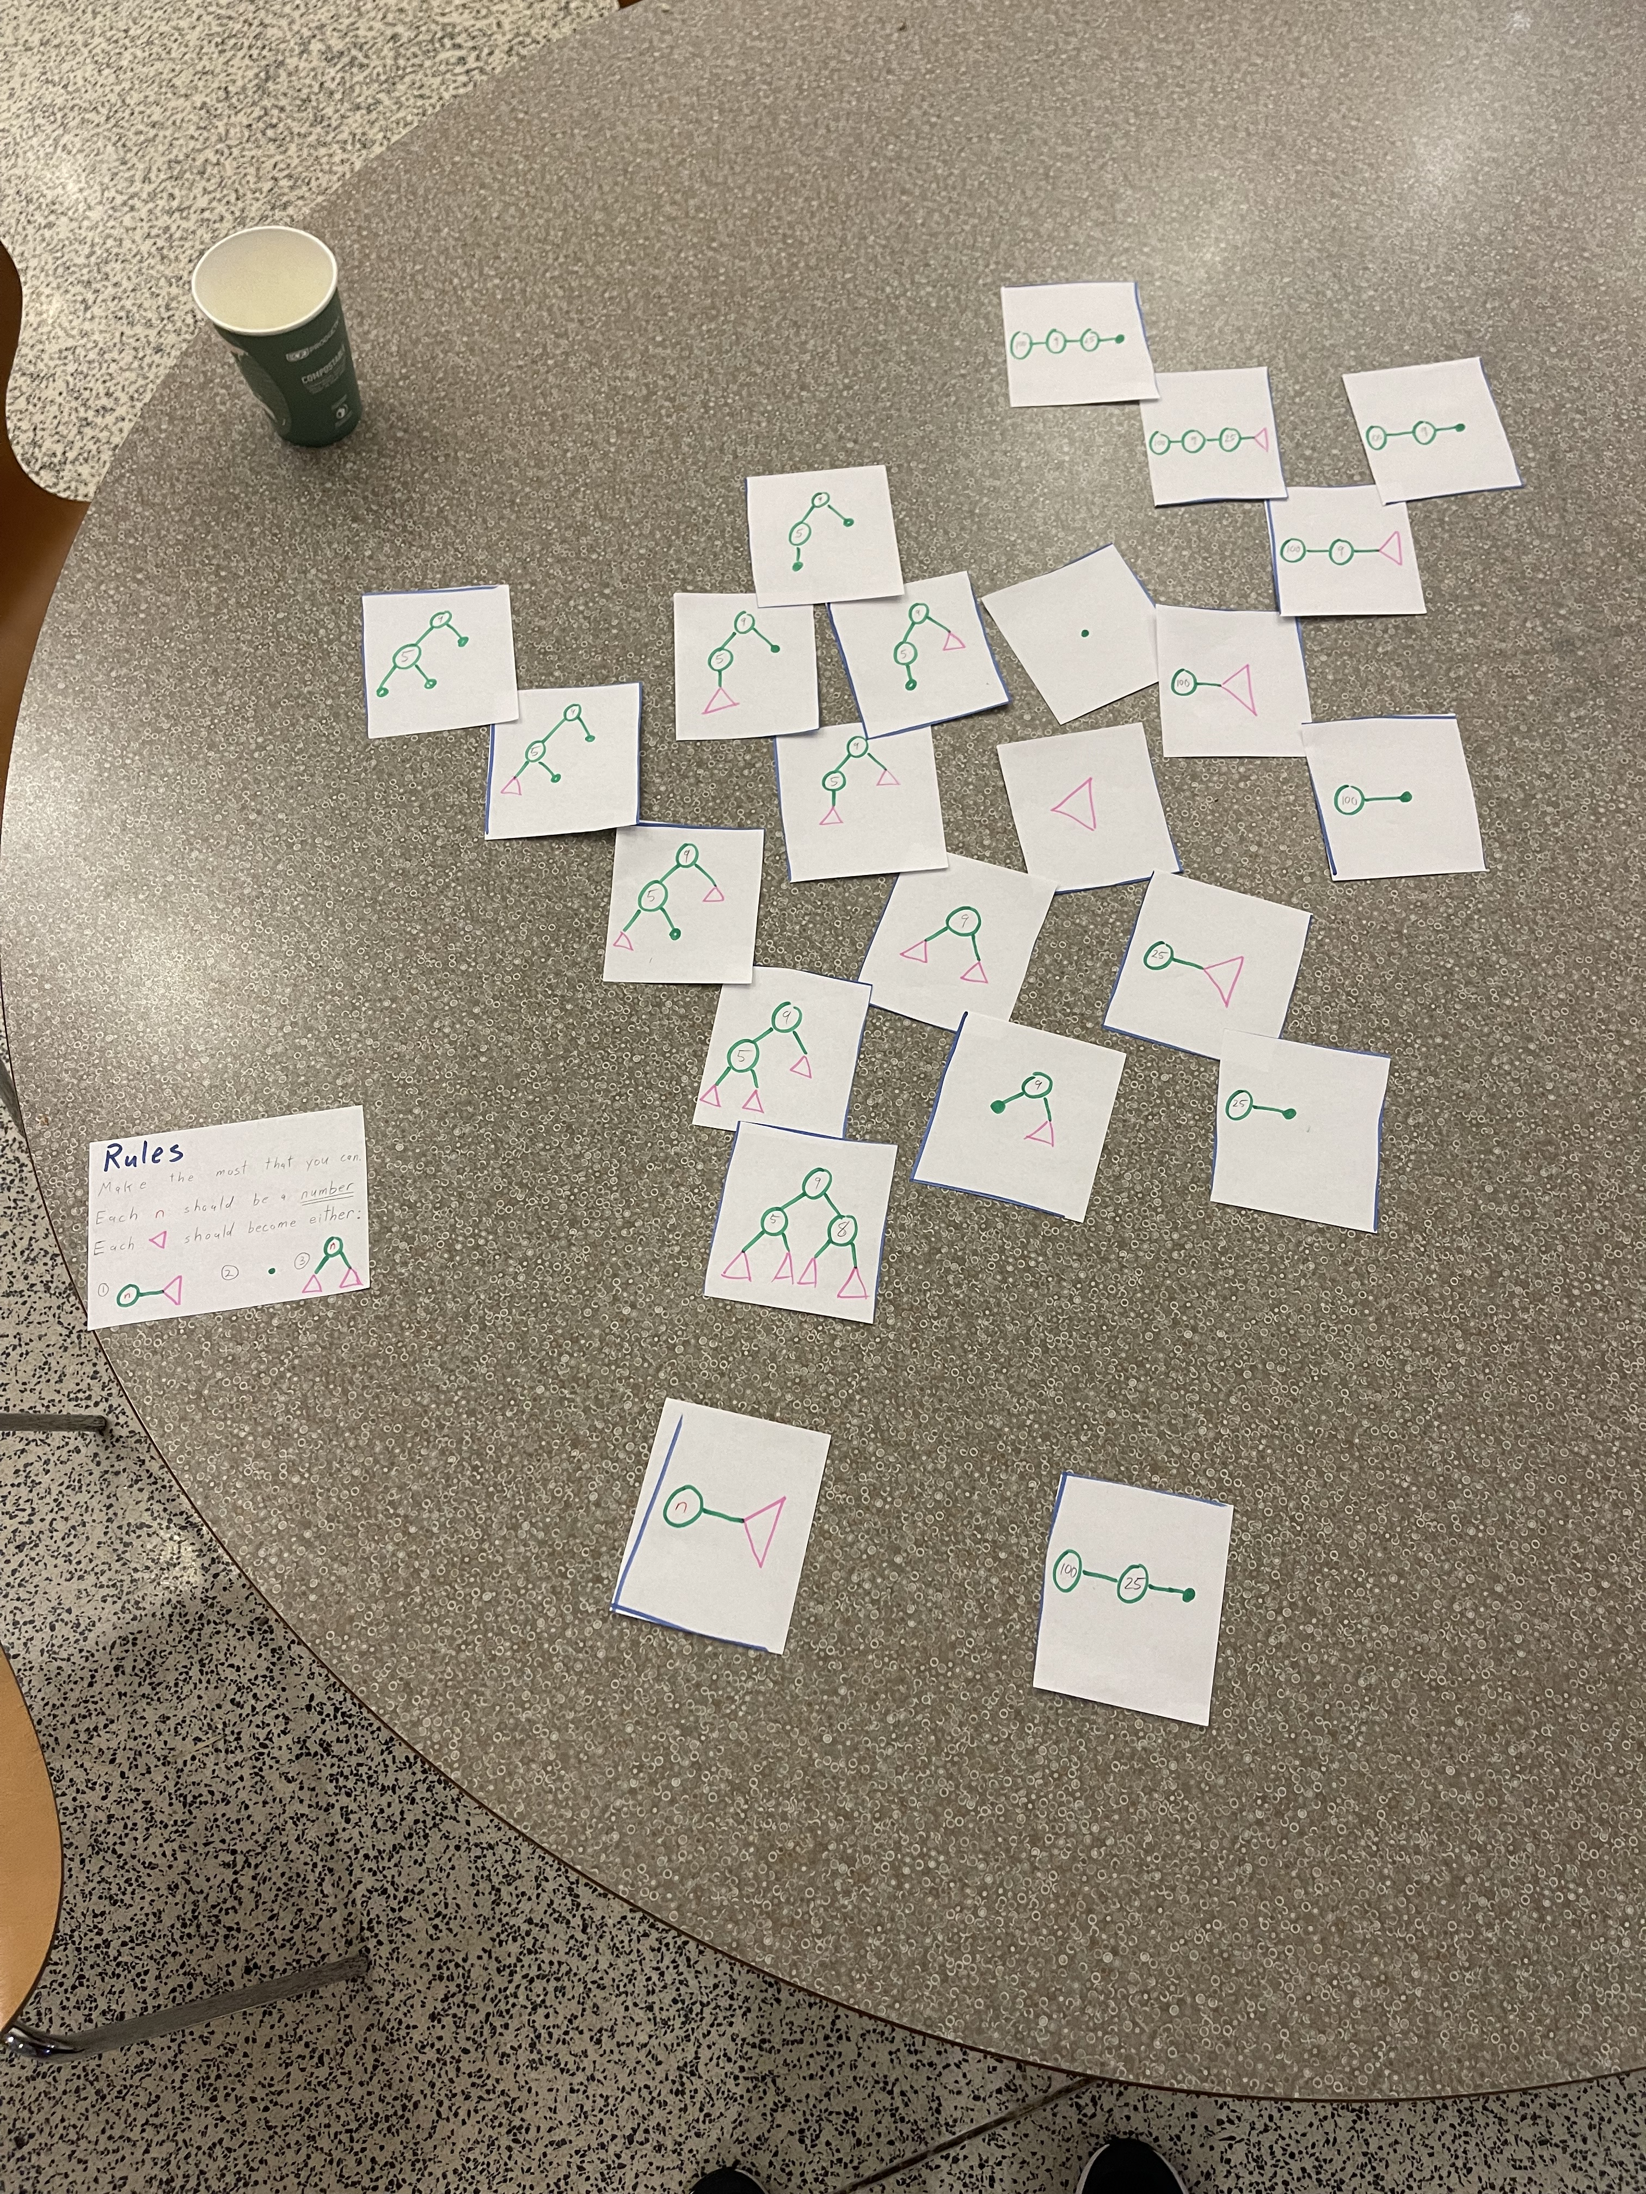
Future Plans
A web forum for learners and educators to share the games they construct as well as the insights they make from each game.
A series of workshops ever expand murals (right)

